Slide 1

Types of Digital Marketing

Slide 2
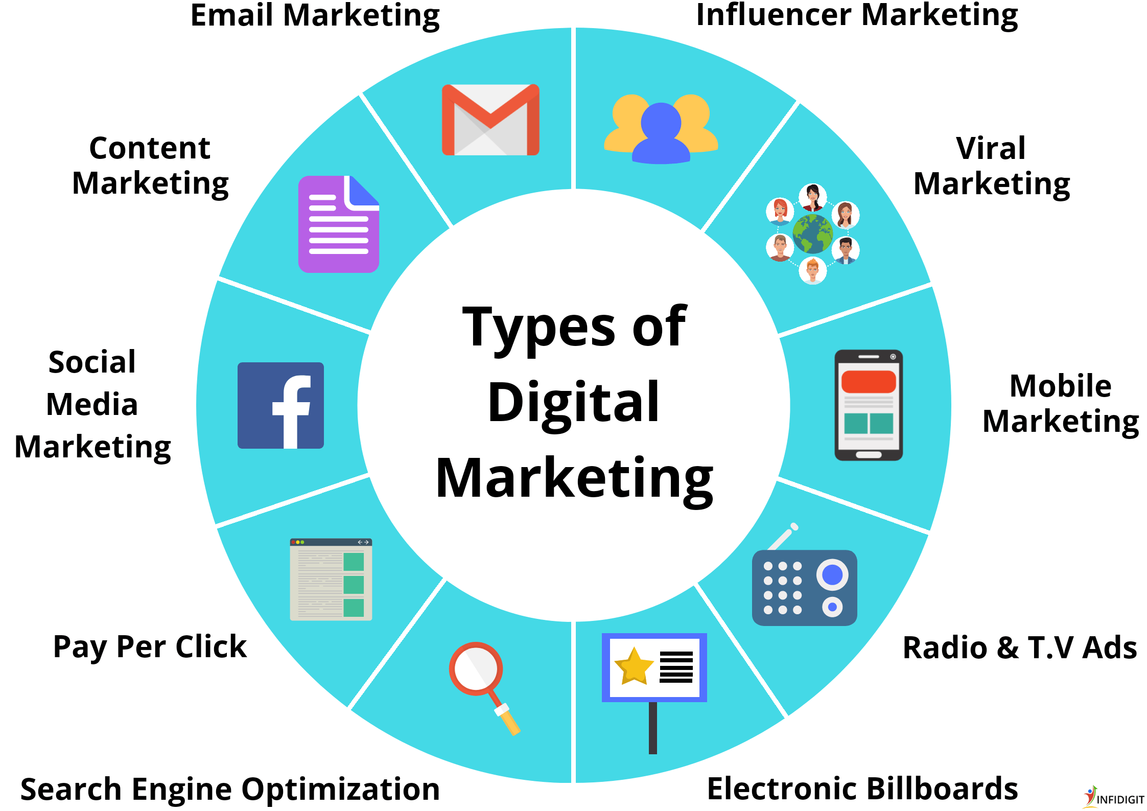
Types of Digital Marketing
What is Digital Marketing? Types & Effective Marketing Strategies (infidigit.com)

Slide 3
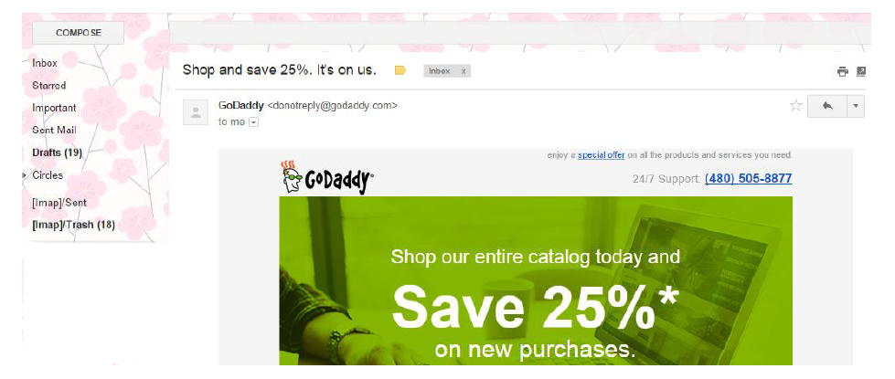
Type of Digital Marketing
Email Marketing

Slide 4

Digital Marketing Overview
What is pay per click (PPC)? (brainstorm)
PPC definition
Pay per click (PPC) is a type of sponsored online advertising that is used on a wide range of websites, including search engines, where the advertiser only pays if a web user clicks on their ad. Hence the title, 'pay per click'.
Advertisers place bids on keywords or phrases that they think their target audience would type in a search field when they are looking for specific goods or services.

Slide 5

Digital Marketing Overview
Advantages of pay per click (PPC)? (brainstorm)
Very fast
Get targeted visitors within hours (sometimes minutes)
Can yield highly profitable results
Great testing platform and can be highly targeted
Time of day
Geographic area
Keywords and phrases
Immediate feedback

Slide 6

Digital Marketing Overview
Disadvantages of pay per click (PPC)?
No guarantees
Heavy competition
You pay regardless of any sales
Competitive keywords demand higher bids
Restricted to text and image ads
Traffic stops when you stop paying

Slide 7
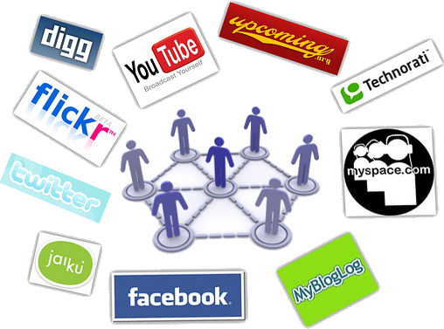
Digital Marketing Overview
What is Social media marketing (SMM)?
Social media marketing definition
Social media is a medium or instrument for communication, like a newspaper or a radio.
Social media = a social instrument of communication.

Slide 8
Digital Marketing Overview
Advantages of social media marketing (SMM)?
Targeted traffic
High return on investment (ROI)
Does not require specialization or vast technical skills
Ability to go viral therefore high visibility
Cost effective (only time and effort)

Slide 9

Digital Marketing Overview
Disadvantages of social media marketing (SMM)?
More time consuming than SEO and PPC
No short term ROI
Everything is public
Ineffective use = brand credibility loss

Slide 10
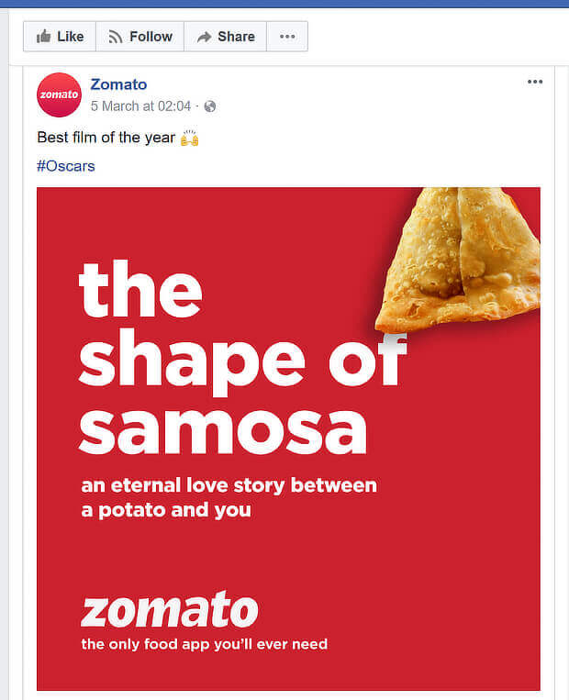
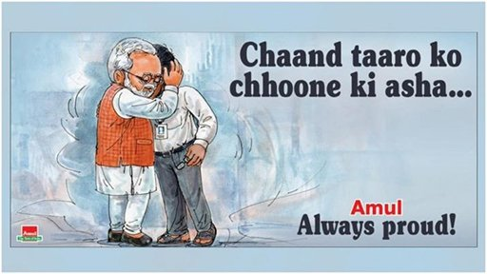
Social Media Marketing

Slide 11
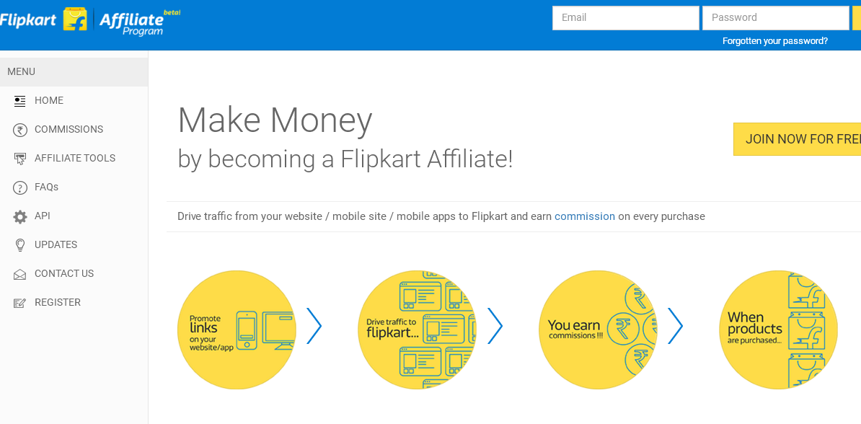
Affiliate Marketing
It refers to the hiring of third parties, also called affiliates, who market a business’s content online.

Slide 12

Digital Marketing Overview
Digital marketing measurement
ROI (return on investment)
Many tools and systems are available to calculate your ROI and to measure the effectiveness of your digital marketing campaign.
ROI tools
Google analytics
Google webmasters tools
Basic google search
Google adwords
Social media monitoring tools
WHICH IS THE MOST EFFECTIVE? Find out and tell us!

Slide 13
How has digital marketing evolved over the years?
With SEO, PPC was born – (pay per click)
Build ads around keywords and pay for everyone that clicks the ad and visits your site
Eg. Google’s Adwords (3 line ads that show up on the right/top of search engine results)
Microsoft’s Adcenter
Yahoo’s search marketing (Overture)

